Slide 1


ROYAL UNIVERSITY
OF PHNOM PENH
IDM: Chapter 1
Introduction to Data Mining
01-10-22 Lecturer Chap Chanpiseth

Slide 2
Course Assessment
Attendance: 10%
One Presentation & One Assignment: 45%
Final exam: 45%

Slide 3
Outline
Introduction
What is Data Mining?
Large-scale Data Everywhere
Why Data Mining?
Data Mining and Great Opportunities to Solve Society’s Major Problems
Why is it called “Data Mining”?
Data Mining and Knowledge Discovery

Slide 4
Outline (Cont.)
Data Mining Tasks
Data Mining Tasks: Predictive tasks
Data Mining Tasks: Descriptive tasks
Clustering
Association Rule Discovery
Motivating Challenges

Slide 5
1) Introduction
This chapter gives a brief introduction to Data Mining (DM) and issues associated with handling large datasets. We shall focus on the statistical aspects of DM.

Slide 6
2) What is Data Mining?
Some definitions
Data mining is the process of finding anomalies, patterns and correlations within large data sets to predict outcomes (SAS Institute Inc.)
Data mining is the nontrivial process of identifying valid, novel, potentially useful, and ultimately understandable patterns in the data (Fayyad)
Data mining is the process of extracting previously unknown, valid, and actionable information from large databases and using it to make crucial business decisions (Zekulin)
DM is the nontrivial process of extracting the implicit, previously unknown and potentially useful information from data. (Frawley et al., 1991)

Slide 7
2) What is Data Mining? (Cont.)
Data mining is the computer automated exploratory data analysis of (usually) large complex data sets. (Friedman, 1998)
DM is the process of Exploration & Analysis of large quantities of data in order to discover meaningful patterns by automatic or semi-automatic means. DM offers also capabilities to make prediction of a future observation. (Tan, et al., 2014)
Notes:
"Non-trivial" is a term used in Computer Science and Mathematics to describe something that requires more than a simplistic or straight-forward approach. Expect to employ advanced knowledge, planning, design, or skill.
"Hard", "difficult", or "challenging" are general-purpose, everyday words, not a part of the disciplines' lexicons. In fact, scientific terminology strives to be as neutral and objective as its purpose is served.
There's nothing that says non-trivial problems have to be hard, difficult, or challenging. It's up to individual subjective judgment. And implementation.
Imagine for a moment professors said "this problem is difficult". Do you think that would help students, or color their perception needlessly?
Simplistic: treating complex issues and problems as if they were much simpler than they really are.

Slide 8


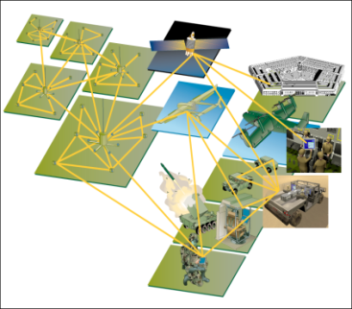
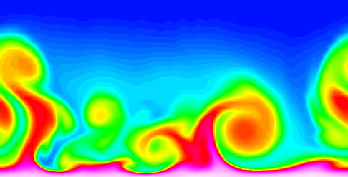
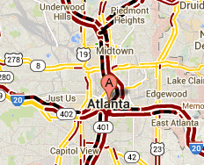
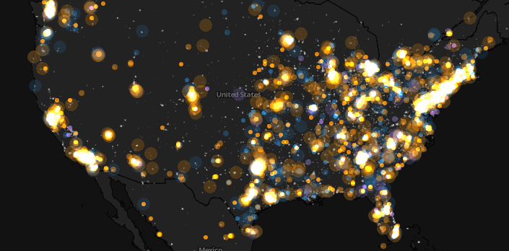
3) Large-scale Data Everywhere
E-Commerce
Sensor Networks
Computational Simulations
Cyber Security
Traffic Patterns
Social Networking: Twitter
7

Slide 9

4) Why Data Mining? Business and Scientific
Business viewpoint:
Tremendous data is being collected and warehoused
Web data
Google has Peta Bytes of web data
Facebook has billions of active users
E-commerce, purchases at department/ grocery stores, e-commerce
Amazon handles millions of visits/day
Bank/Credit Card transactions
Computers have become cheaper and more powerful
Competitive Pressure is Strong
Provide better Customer Relationship Management

Slide 10
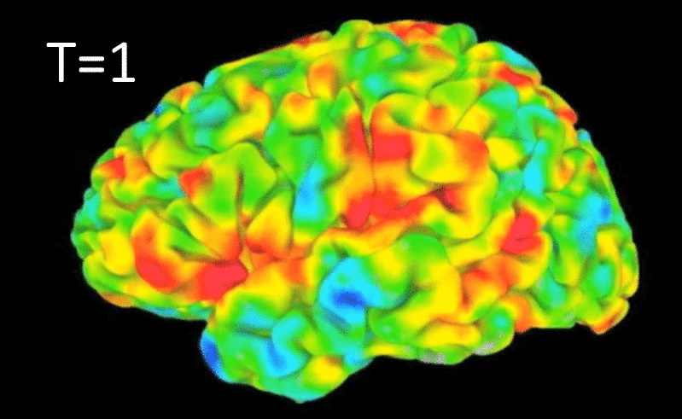
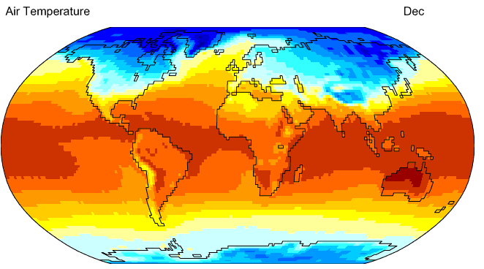
Why Data Mining? Business and Scientific (Cont.)
Scientific viewpoint
Data collected and stored at fast speeds
Remote sensors on a satellite
NASA EOSDIS archives over petabytes of earth science data / year
Telescopes scanning the skies
Sky survey data
High-throughput biological data
scientific simulations
Terabytes of data generated in a few hours
Data mining helps scientists
in automated analysis of massive datasets
In hypothesis formation
Sky survey data
Gene Expression Data
Surface temperature of earth
fMRI Data from Brain
Notes:
This review focuses on current data mining techniques used in classification and clustering of gene expression dataset. Main attention is given to supervise and unsupervised methods that are being used recently to classify gene expression for the purpose of diagnosis and prognosis of terrifying diseases. In fact, gene expression data clustering offers a powerful approach to detect cancers from a given dataset. The various efficient algorithms available in the literature are analyzed to know their availability in the different situations.

Slide 11
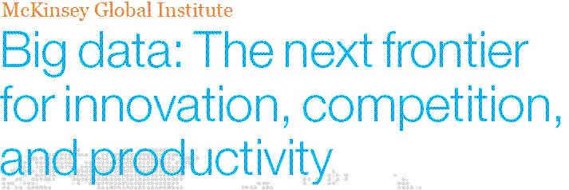
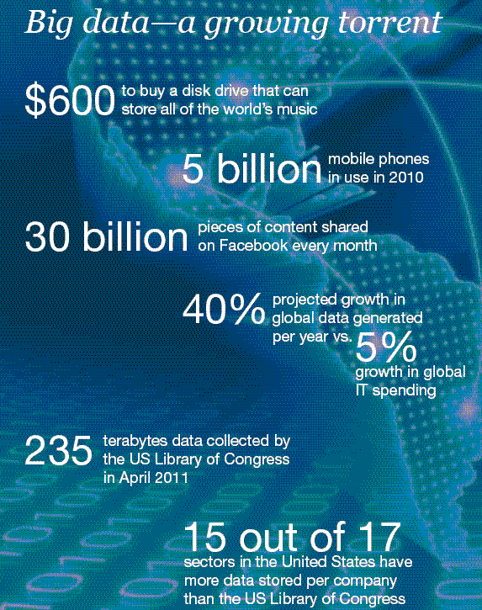
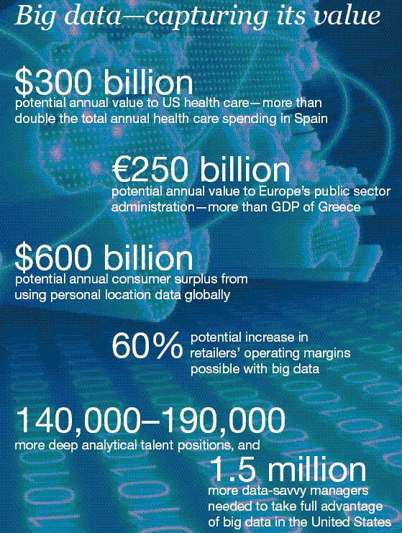
5) Great opportunities to improve productivity in all walks of life
Notes:
User Growth with time
X the time period by trimester
– Accumulative number of users in y axis
- Over 3 years.

Slide 12
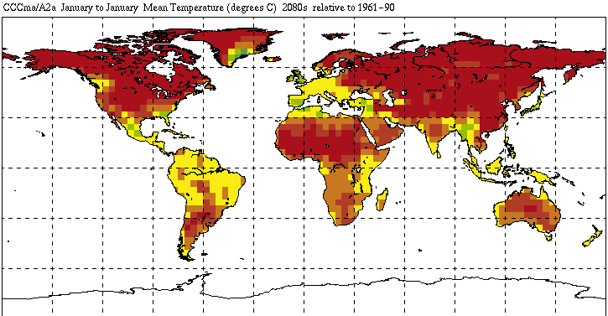



5) Great Opportunities to Solve Society’s Major Problems (Cont.)
Improving health care and reducing costs
Predicting the impact of climate change
Finding alternative/ green energy sources
Reducing hunger and poverty by
increasing agriculture production
Notes:
- 2 sub clusters of users: experience a lots and gave one time measurements and left forever

Slide 13
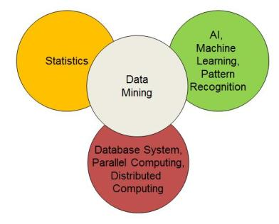
6) Why is it called “Data Mining”?
The convergence of statistics, machine learning/AI, pattern recognition and database systems
Some statisticians have used the term “data mining” to mean unsavoury “data dredging”, “data snooping”’ or “fishing expedition”.
Traditional techniques may be unsuitable due to data that is
Large-scale, High dimensional, Heterogeneous, Complex, Distributed
The focus of DM is often prediction and not statistical inference.
There is no firm distinction between DM and statistics.
Notes:
Want to understand the frequency of app usages in DAY level. How active user was after downloading the app.

Slide 14
6.I) Data Mining and Knowledge Discovery
Data mining is an integral part of knowledge discovery in databases (KDD)
The process of KKD consists of a series of transformation steps, from data preprocessing to postprocessing.
Fig. 1: the process of knowledge discovery in databases (KDD).
Notes:
Spurious is a term used to describe a statistical relationship between two variables that would, at first glance, appear to be causally related, but upon closer examination, only appear so by coincidence or due to the role of a third, intermediary variable.

Slide 15
6.I) Data Mining and Knowledge Discovery (Cont.)
Preprocessing: is to transform the raw data into an appropriate format for subsequent analysis.
Data Cleaning: remove noise, duplicate observations and inconsistent data
Data integration: combining the data from multiple data sources
Data selection: data relevant to the analysis task are retrieved from the database.
Data transformation: data are transformed and consolidated into forms appropriate for mining by performing summary or aggregation operations.
Postprocessing:
Pattern Evaluation: to eliminate spurious data mining result
Knowledge presentation: using visualization and knowledge representation techniques
Notes:
Spurious is a term used to describe a statistical relationship between two variables that would, at first glance, appear to be causally related, but upon closer examination, only appear so by coincidence or due to the role of a third, intermediary variable.

Slide 16
7) Data Mining Tasks
Broadly divided into two major categories
Predictive tasks
Use some attributes to predict unknown or future values of other attributes.
Descriptive tasks
Find human-interpretable patterns that describe the data.
Notes:
The objective is to derive patterns such as trends, clusters and anomalies that summarize underlying relationships in data. These tasks are often exploratory in nature and frequently require post-processing techniques to validate and explain the results.

Slide 17
7.I) Data Mining Tasks: Predictive tasks
There are Two types of Predictive Modelling tasks:
Classification: used for discrete target variables. For example, predicting whether a Web user will make a purchase at an online bookstore.
Regression: approximate a mapping function (f) from input variables (X) to a continuous output variable (y).
The goal of both Classification and Regression is to learn a model that minimizes the error between the predicted and true value of the target variable.

Slide 18
7.II) Data Mining Tasks: Descriptive tasks
There are Three types of Descriptive Modelling tasks:
Association Rule Discovery: is used to discover patterns that describe strongly associated features in the data. The patterns are typically represented in the form of association rules.
Cluster Analysis : seeks to find groups of closely related observations so that observations that belong to the same cluster are more similar to each other than observations that belong to other clusters. Clustering is the task of segmenting a heterogeneous population into more homogeneous subgroups or clusters.
Anomaly Detection: identify observations whose characteristics are significantly different from the rest of the data. Such observations are known as anomalies or outliers.

Slide 19
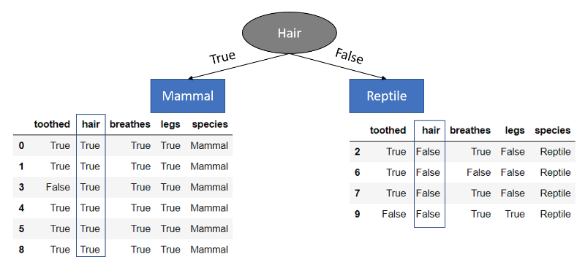
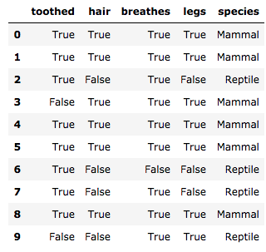


Examples of Data Mining Tasks
Clustering
Predictive
Modeling
Anomaly Detection
Association Rules
Milk
Notes:
Want to understand the frequency of app usages in DAY level. How active user was after downloading the app.

Slide 20
An example of Predictive tasks: Classification
Model for predicting credit worthiness
Class

Slide 21
An example of Predictive tasks: Classification (Cont.)
categorical
categorical
quantitative
class
Test
Set
Learn
Classifier
Training Set
Model

Slide 22
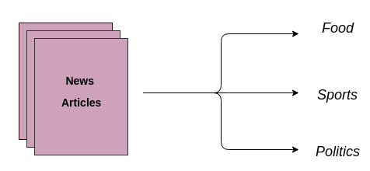


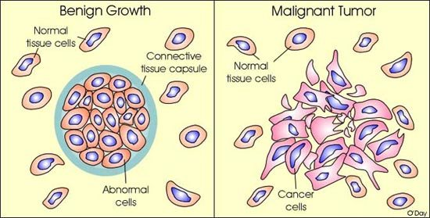
Examples of classification task
Categorizing news stories as finance,
weather, entertainment, sports, etc
Classifying credit card transactions
as legitimate or fraudulent
Identifying intruders in the cyberspace
Predicting tumour cells as benign or malignant

Slide 23
Classification: Classifying news category
News classification
Goal: Automatically identify news category given news headline and short description
Approach:
Collect the articles of different categories from various sources
Label articles to corresponding category. This forms the class attribute.
Learn a model for the class of the articles.
Use this model to classify a category to which a news belongs

Slide 24
Classification: Classifying credit card transactions
Fraud Detection
Goal: Predict fraudulent cases in credit card transactions.
Approach:
Use credit card transactions and the information on its account-holder as attributes.
When does a customer buy, what does he buy, how often he pays on time, etc
Label past transactions as fraud or fair transactions. This forms the class attribute.
Learn a model for the class of the transactions.
Use this model to detect fraud by observing credit card transactions on an account.

Slide 25
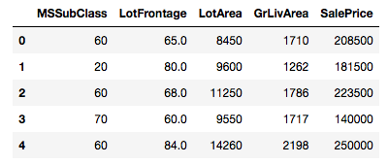
Predictive tasks: Regression

Slide 26
Predictive tasks: Regression
Predicting sales amounts of new product based on advertising expenditure.
Predicting wind velocities as a function of temperature, humidity, air pressure, etc.
Time series prediction of stock market indices.

Slide 27
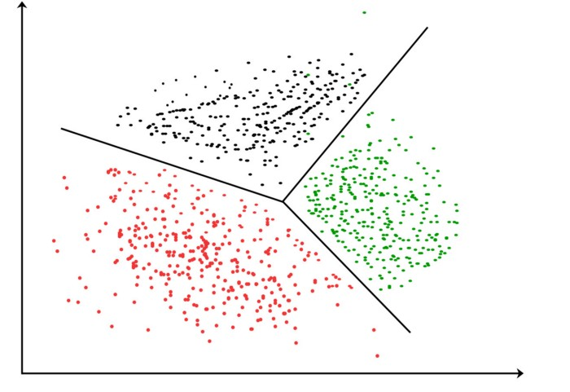
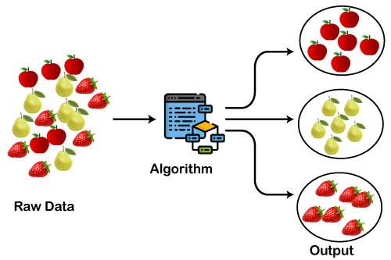
8) Clustering
Finding groups of objects such that the objects in a group will be similar (or related) to one another and different from (or unrelated to) the objects in other groups

Slide 28
Clustering: Applications
Recommendation engines
Market segmentation
Social network analysis
Medical imaging
Image segmentation
Notes:
Social network analysis (SNA) is the process of investigating social structures through the use of networks and graph theory. It characterizes networked structures in terms of nodes (individual actors, people, or things within the network) and the ties, edges, or links (relationships or interactions) that connect them.

Slide 29
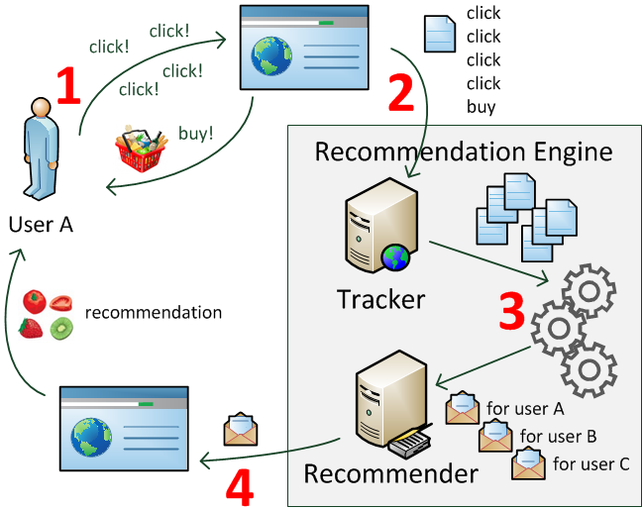
Clustering Applications: Recommendation engines
Recommendation engines
Goal: To suggest products, services, information to users based on analysis of data
Approach:

Slide 30
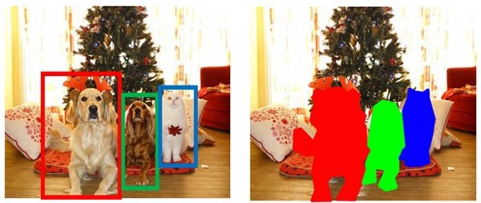
Clustering Applications: Image segmentation
Image segmentation
Goal: The process of assigning a label to every pixel in an image such that pixels with the same label share certain characteristic
Approach:

Slide 31
Clustering Applications: Document clustering
Document Clustering
Goal: To find groups of documents that are similar to each other based on the important terms appearing in them.
Approach:
To identify frequently occurring terms in each document.
Form a similarity measure based on the frequencies of different terms.
Can utilize the clusters to relate a new document or search term to clustered documents.

Slide 32
9) Association Rule Discovery
Given a set of records each of which contain some number of items from a given collection
Produce dependency rules which will predict occurrence of an item based on occurrences of other items.
Rules Discovered:
{Milk} --> {Coke}
{Diaper, Milk} --> {Beer}

Slide 33
Association Analysis: Applications
Market-basket analysis
Rules are used for sales promotion, shelf management, and inventory management
Medical Informatics
Rules are used to find combination of patient symptoms and test results associated with certain diseases

Slide 34
10) Motivating Challenges
Scalability:
Scalable algorithms to handle exponential search
Novel data structures
Out-of-core algorithms when processing data sets that cannot fit into main memory
Parallel and distributed algorithms
High Dimensionality
Data involving thousands of features.
Heterogeneous and Complex Data
Heterogeneous attributes
Semi-structured text and hyperlinks
Time series measurements temperature, pressure, etc.
Graph connectivity

Slide 35
10) Motivating Challenges (Cont.)
Data Ownership and Distribution
The data needed is geographically distributed among resources belonging to multiple entities
how to reduce the amount of communication needed to perform the distributed computation,
how to effectively consolidate the data mining results obtained from multiple sources, and
how to address data security issues.
Non-traditional Analysis
The traditional statistical approach => extremely labor-intensive
It is based on a hypothesize-and-test paradigm.
With this regards, a hypothesis is proposed,
An experiment is designed to gather the data, and then
The data is analyzed with respect to the hypothesis.
Current data analysis tasks
Explore the patterns from data using thousands of hypotheses, and consequently,
Propose the automation process of hypothesis generation and evaluation.
The data sets of data mining are collected from random samples, unstructured-data, semi-structure data or structure data

Slide 36
References
Introduction to Data Mining by Kumar,Tan, Steinbach.
Data Mining Concepts and Techniques by Han, Kamber, Pie, Third Edition, Elsevier.
Statistical and Machine-Learning Data Mining by Bruce Ratner

Slide 37
Video
fMRI
https://youtu.be/0uSYLy9itgg

Slide 38

Thanks for your attention !

